Slide 1

Group 3
Software Manager: Dirk Thieme
Hardware Manager: Erik Manis
Project Controller: Mohammed Ansari

Slide 2
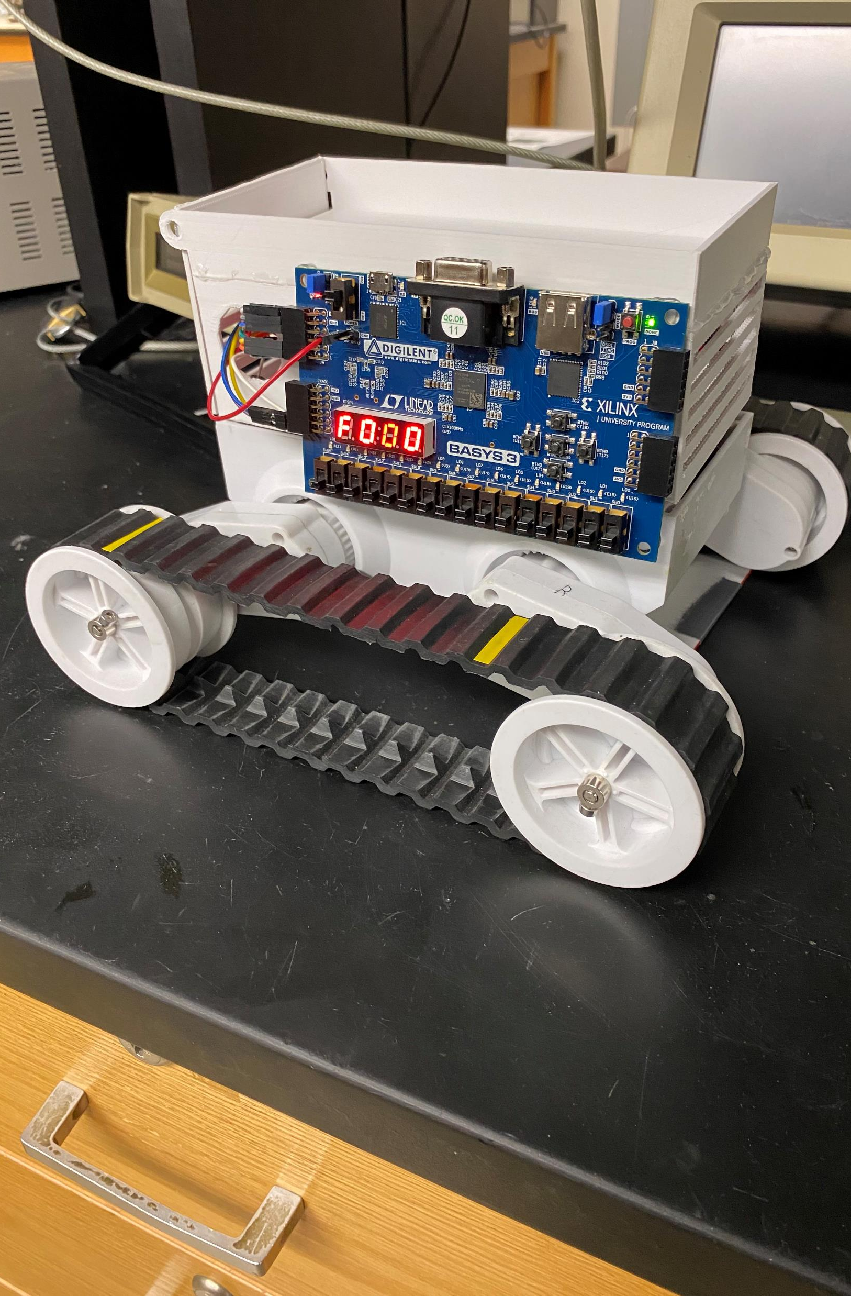
Rover Mini Project
Summary: Use the BASYS 3 board’s built-in switches to control the speed and direction of the motors inside of a rover based on which switch is pulled.
Goals: Build a better understanding of the board, the h-bridge, and the Verilog software.

Slide 3
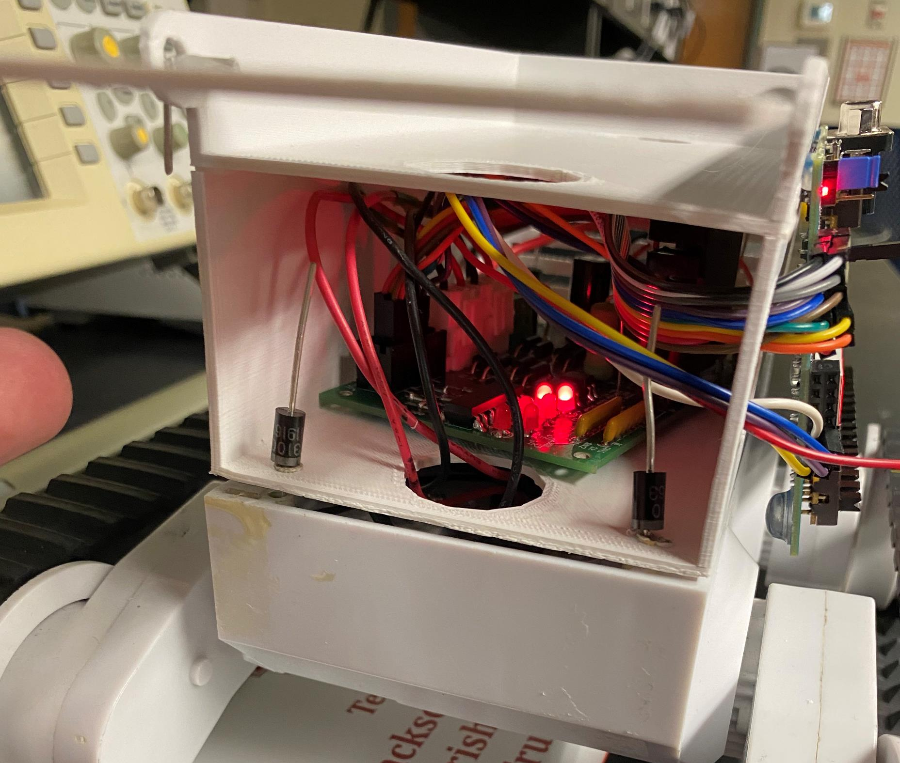
Hardware Update

Slide 4
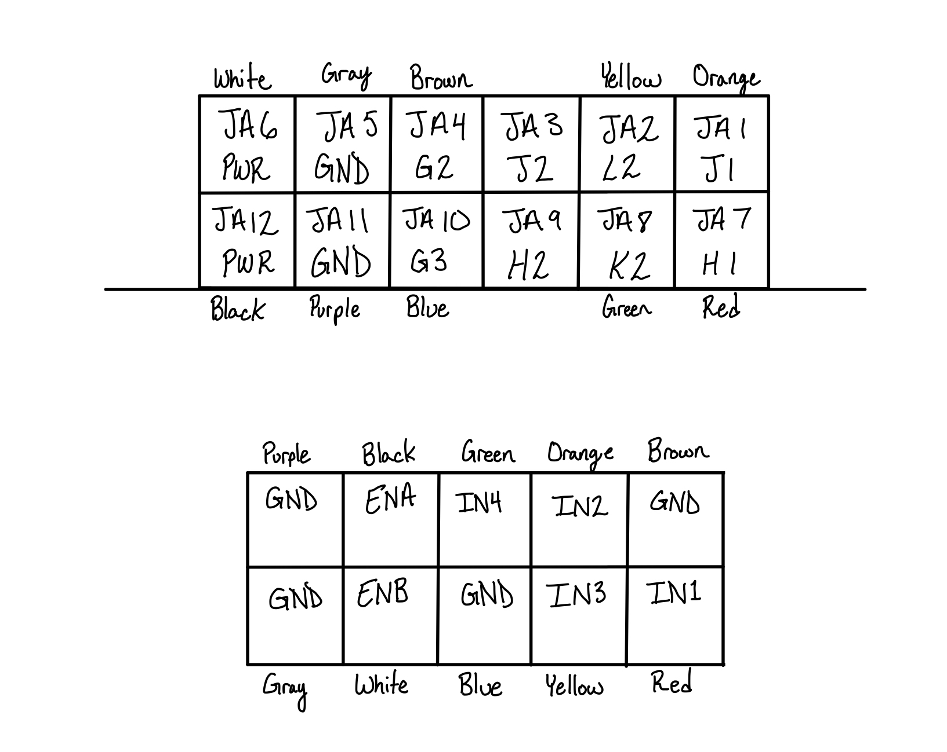
Hardware Update
PMOD

Slide 5
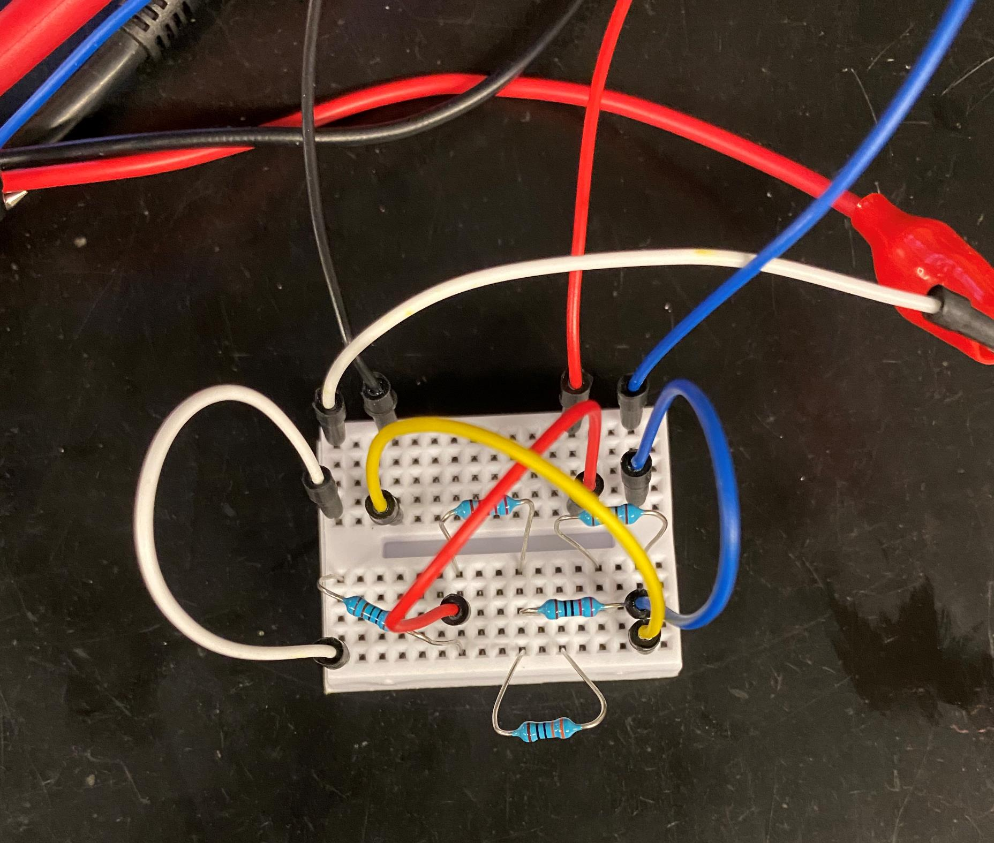
Hardware Update

Slide 6
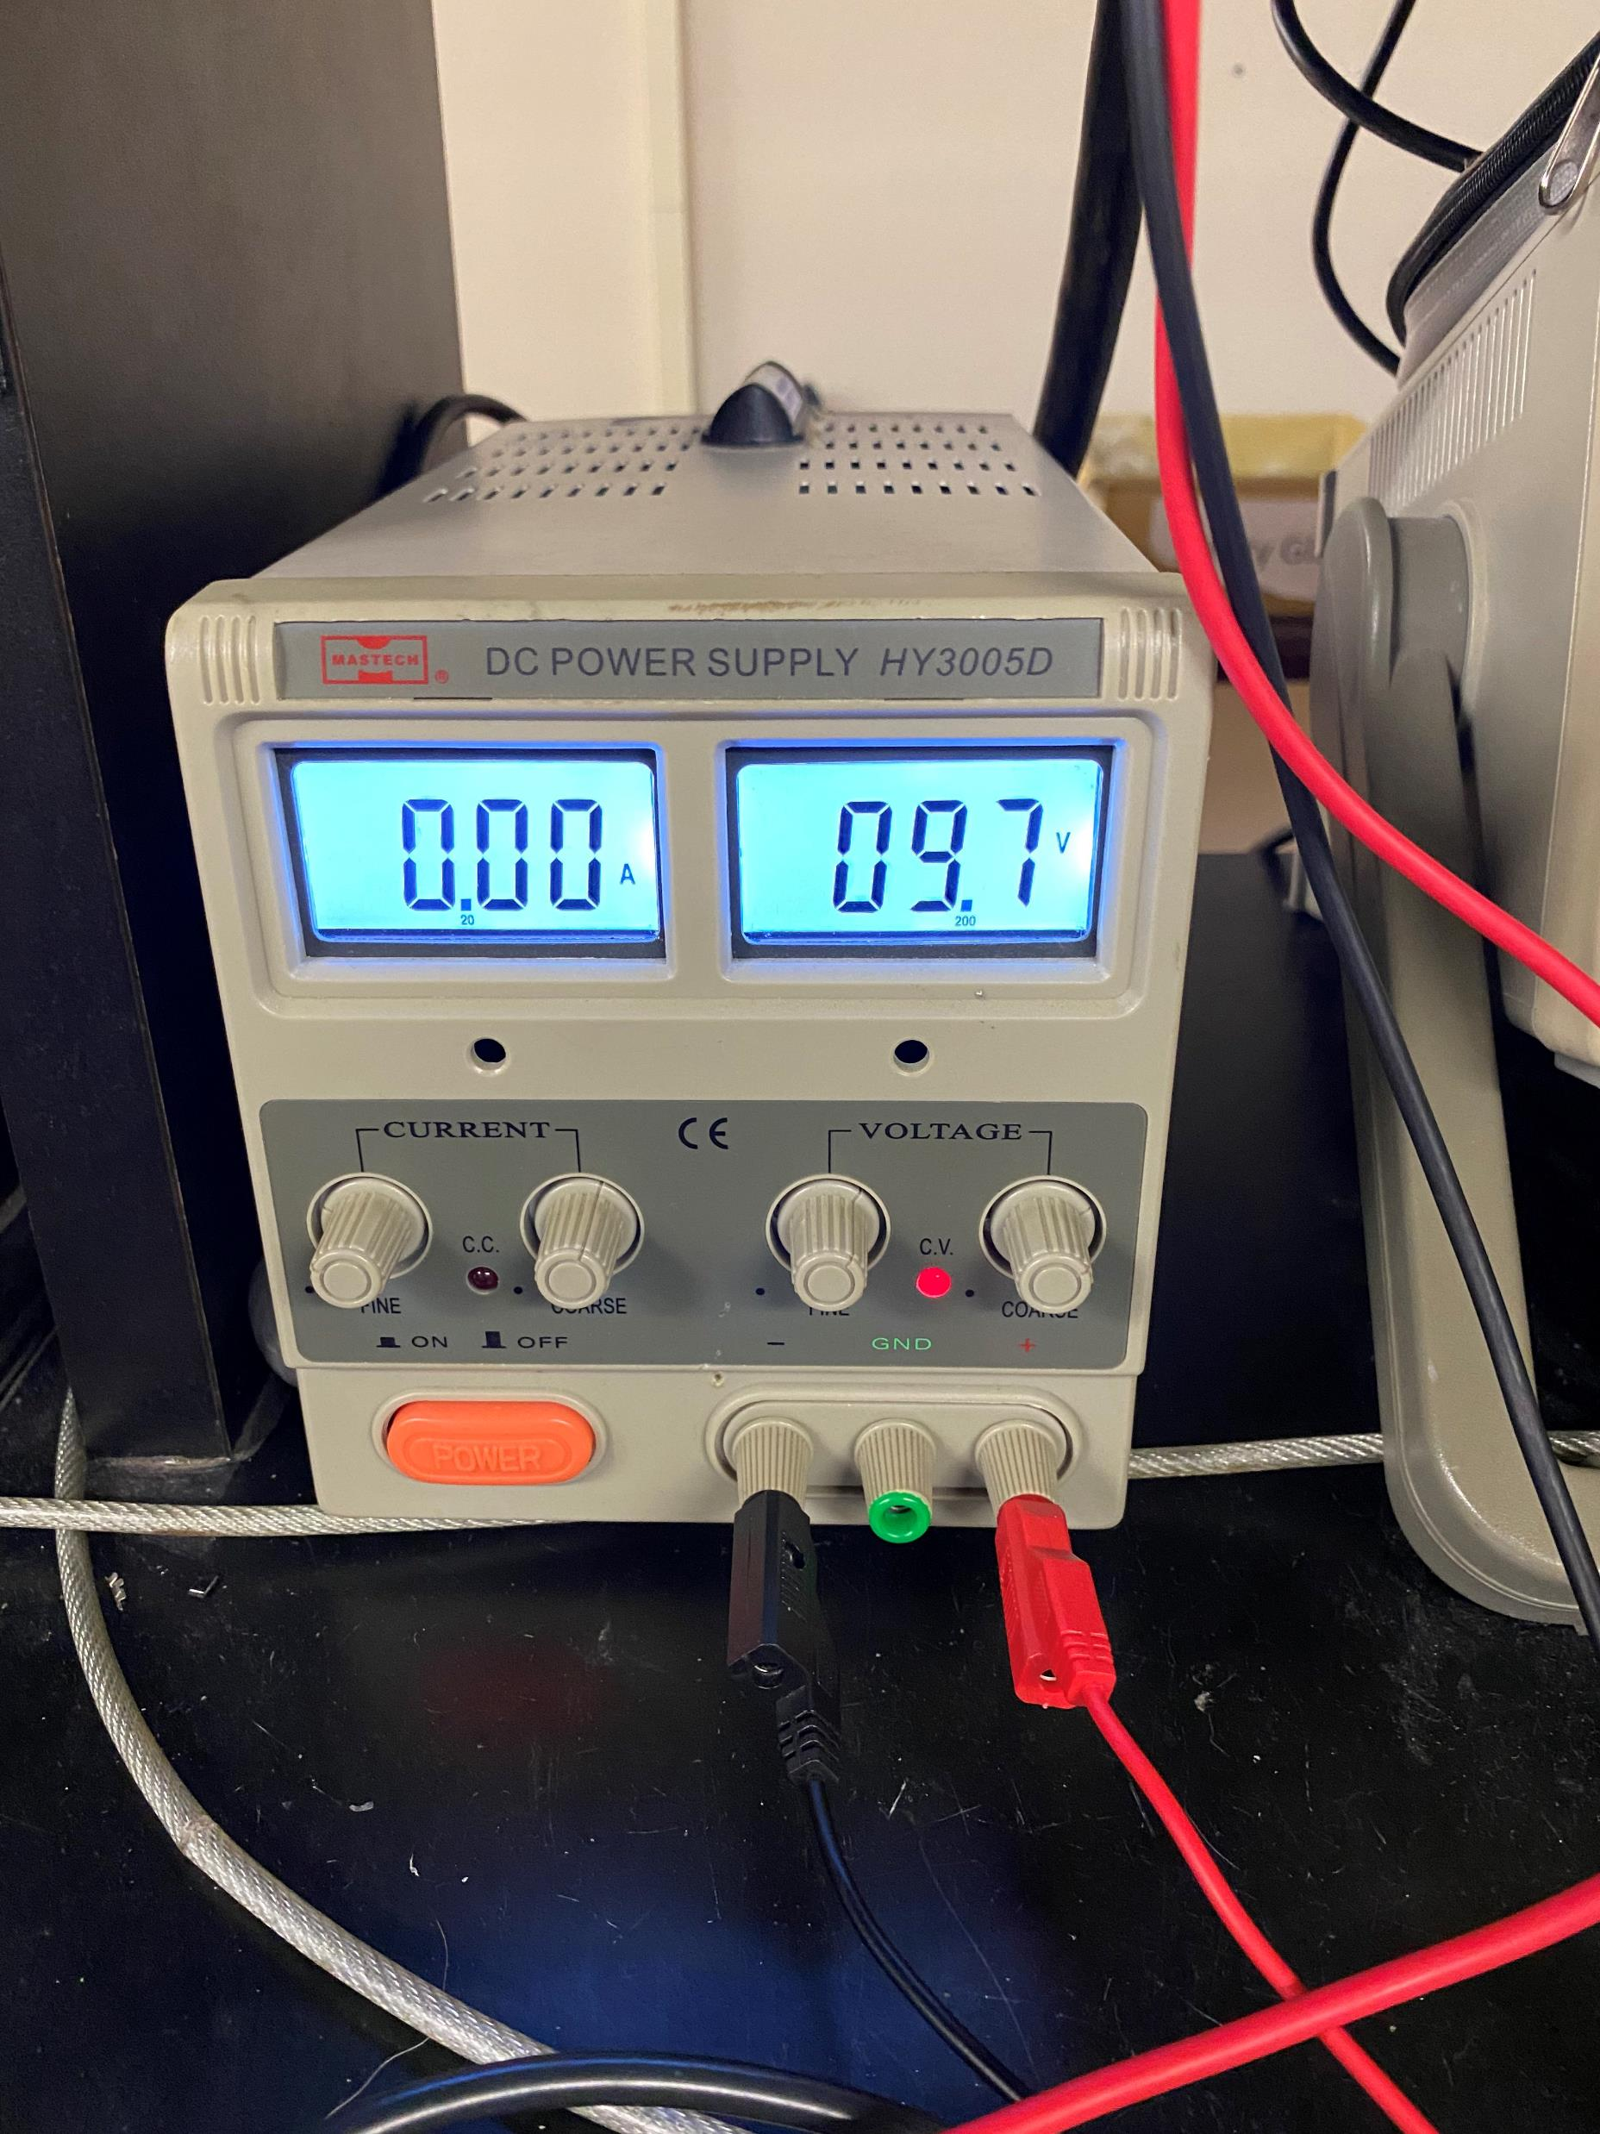
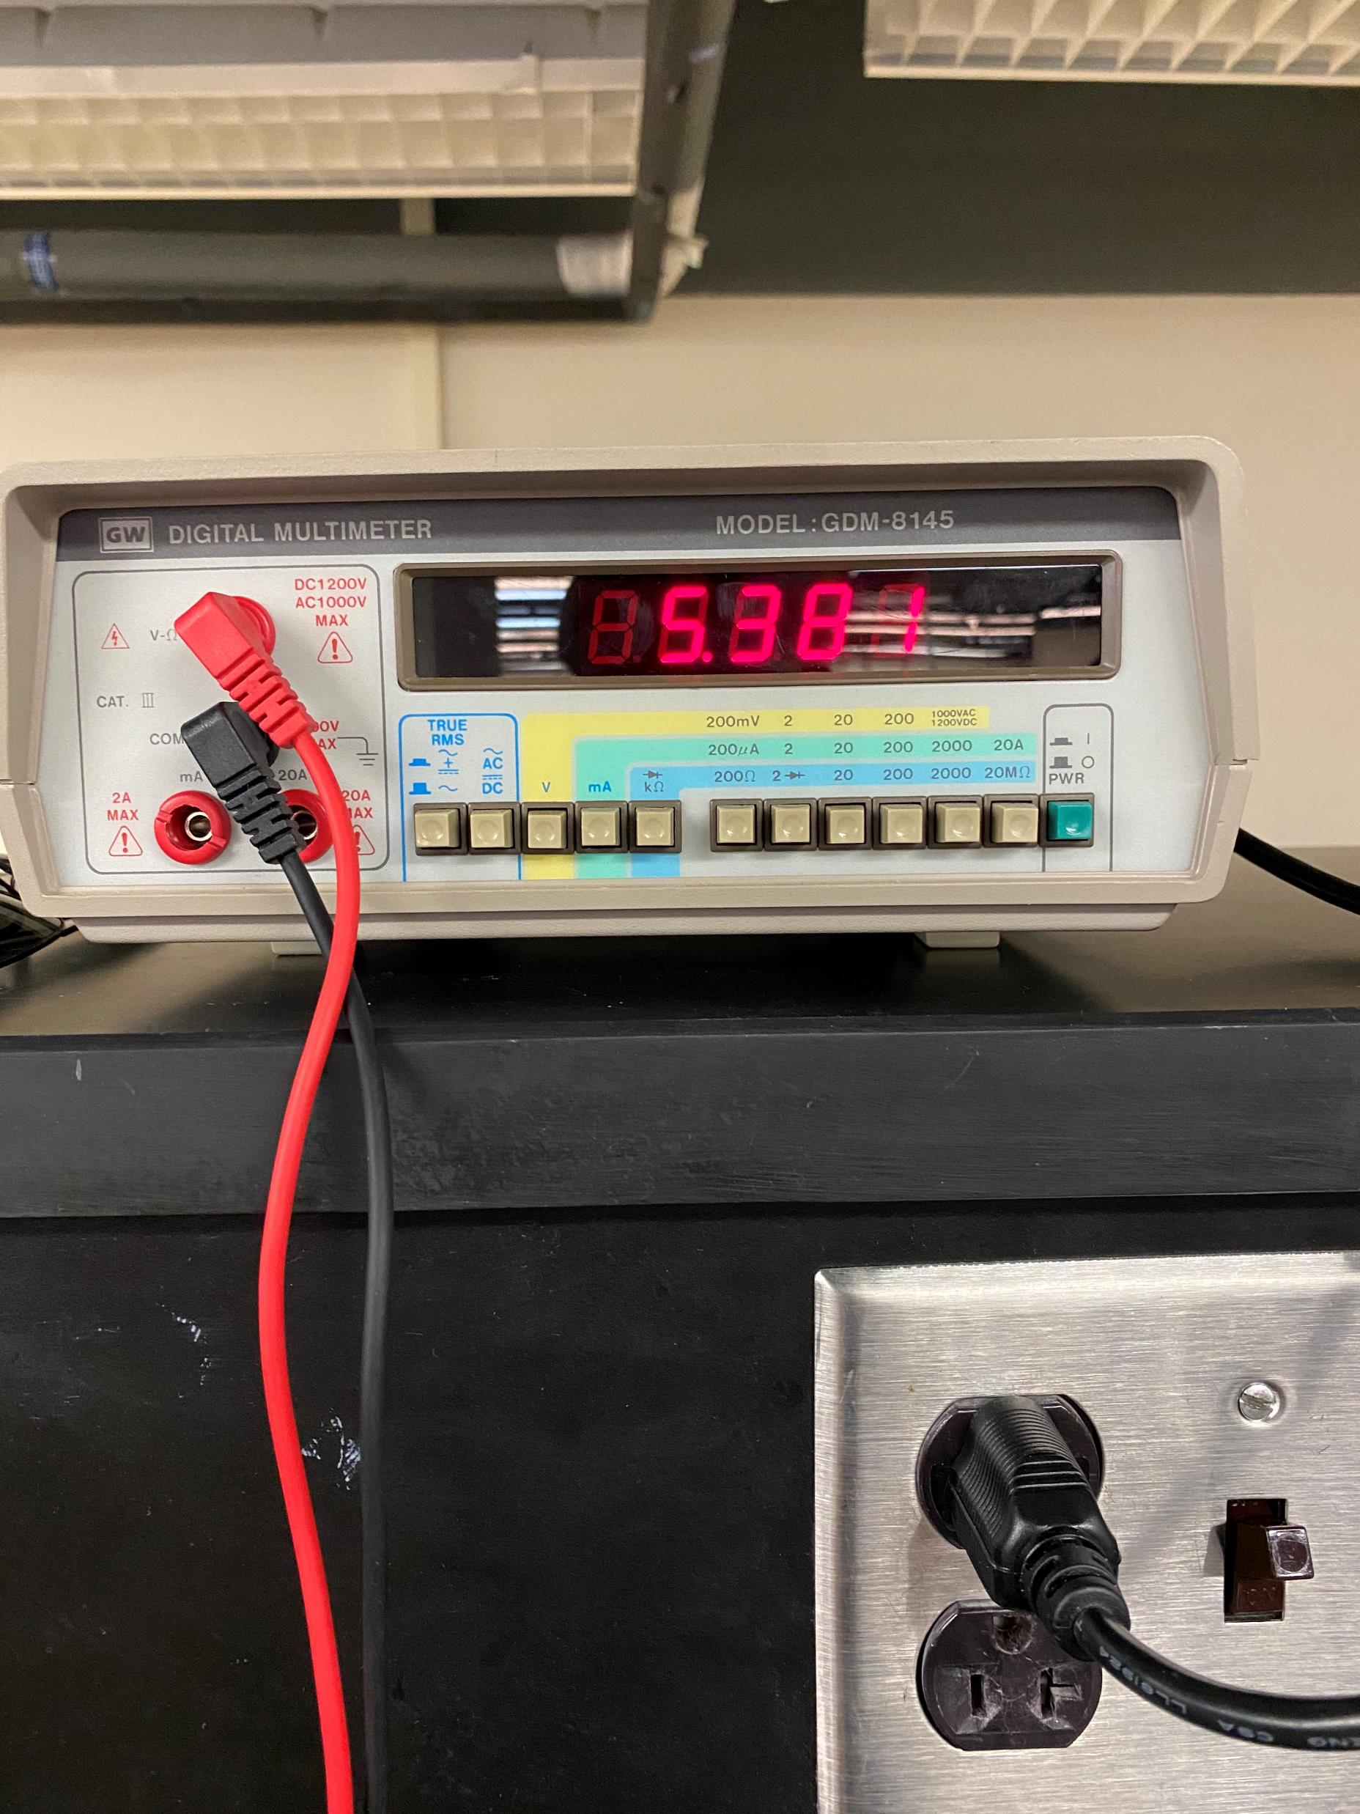
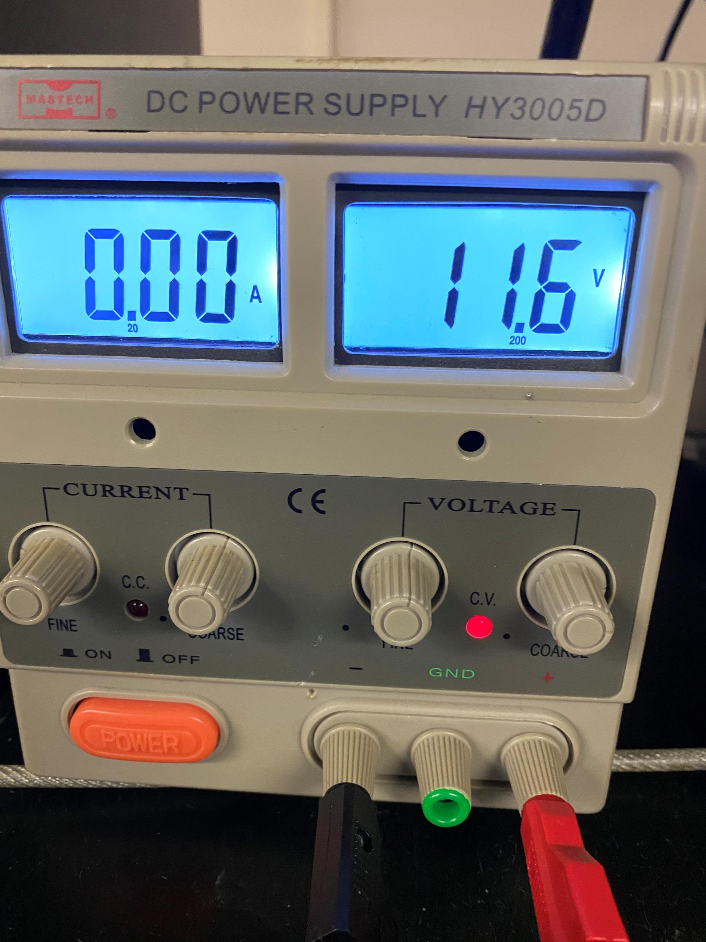
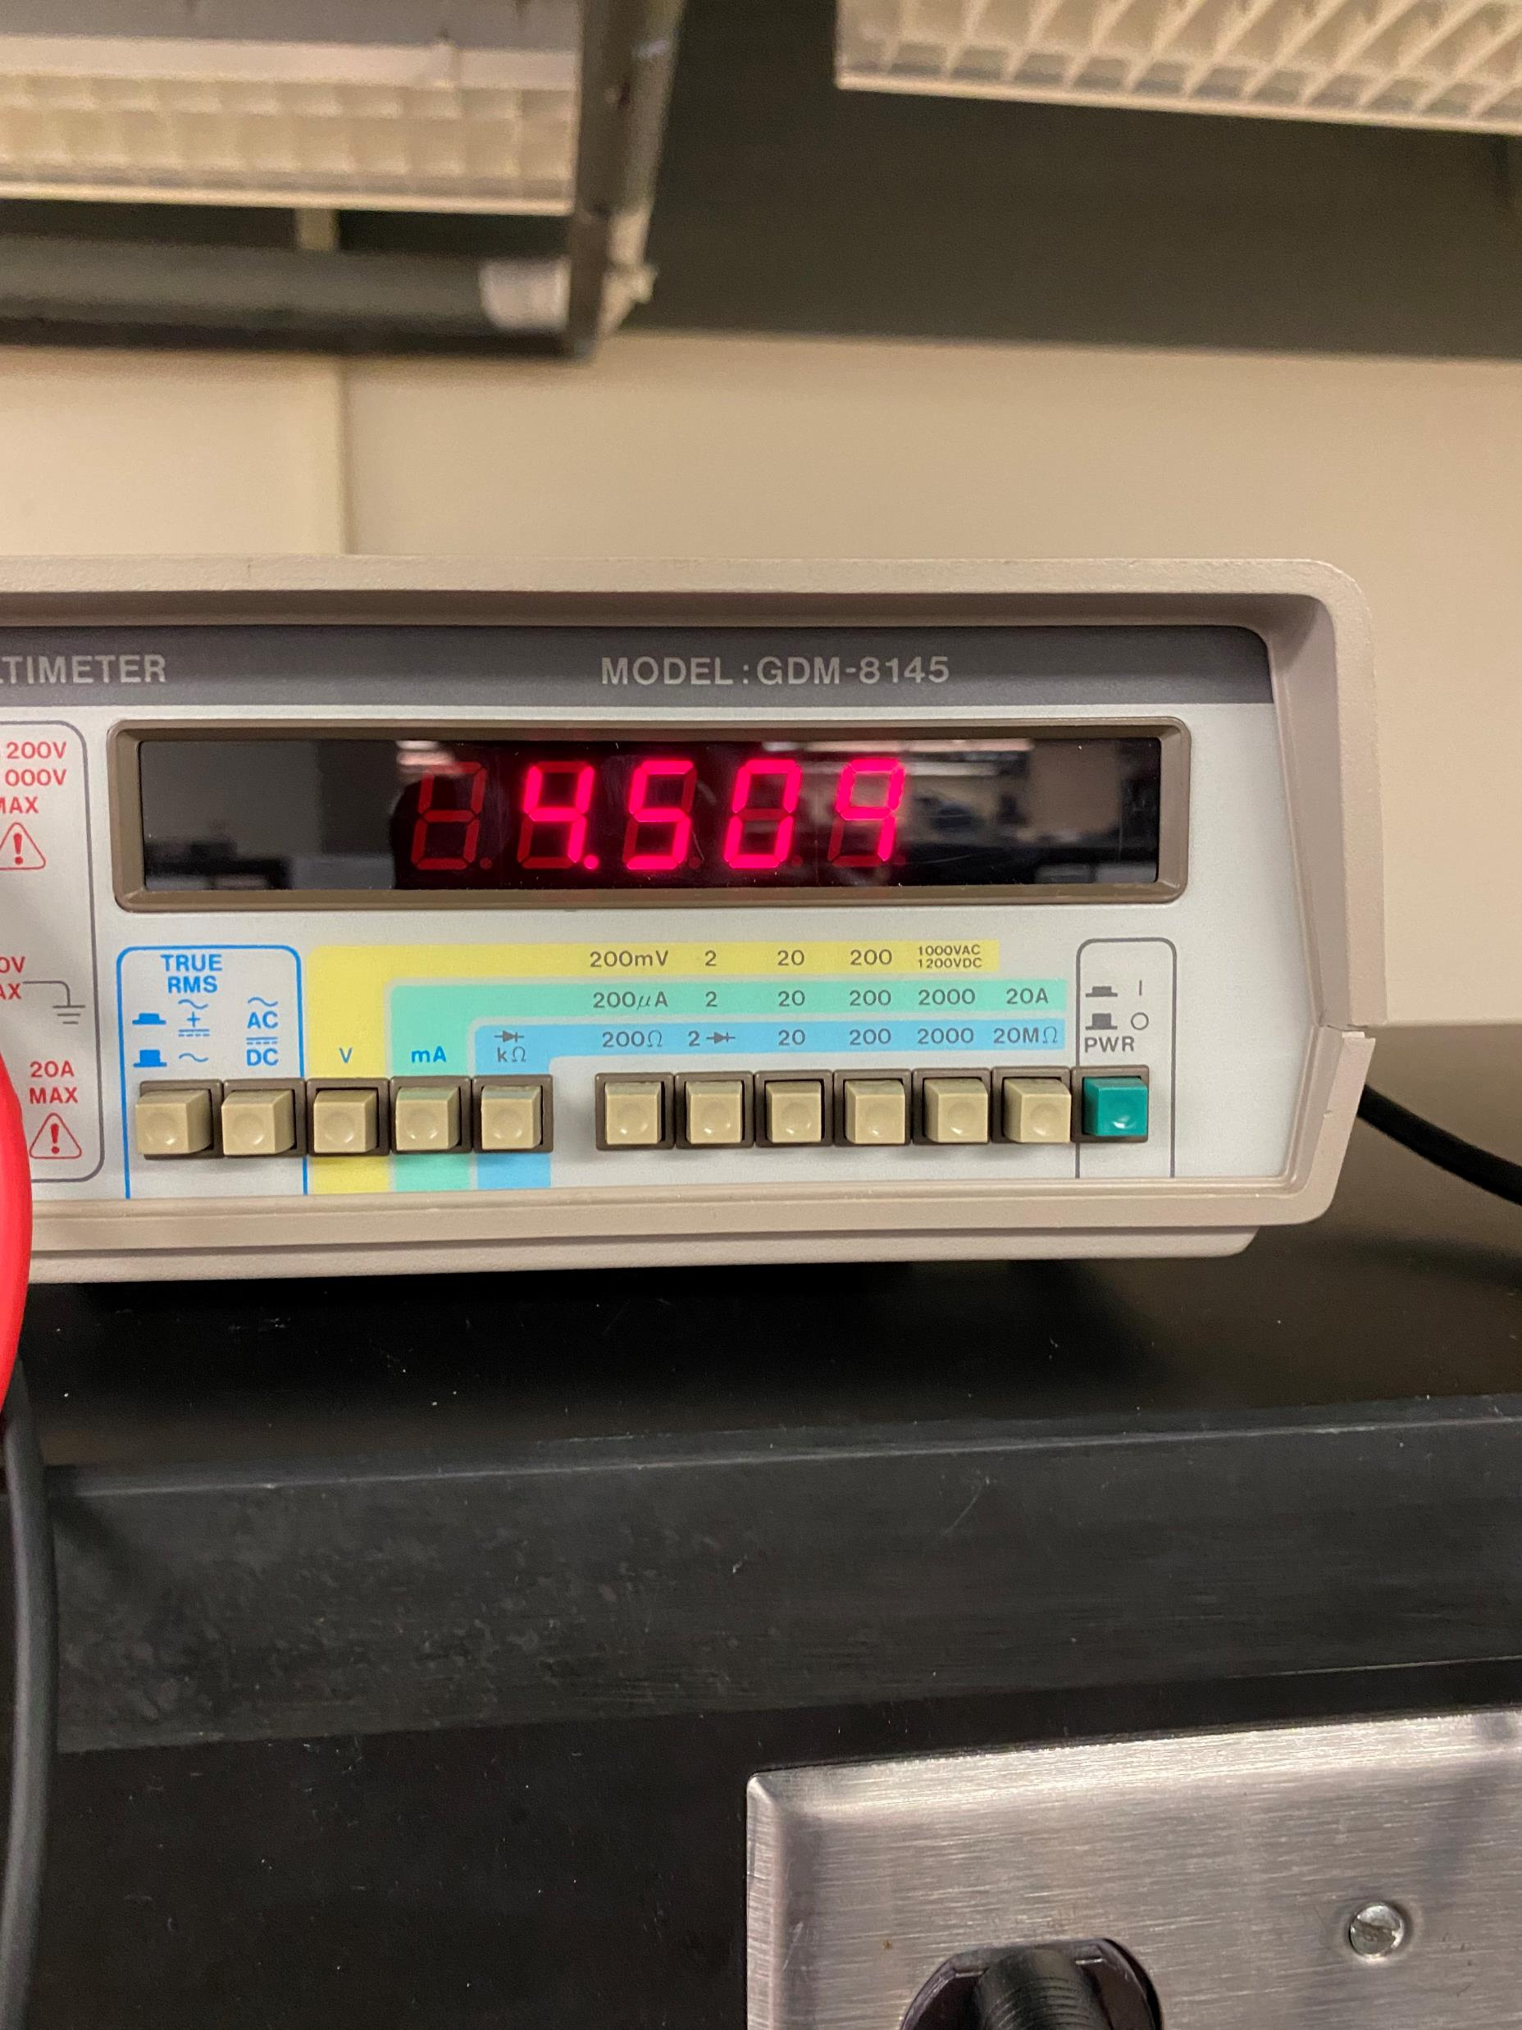
Hardware Update

Slide 7
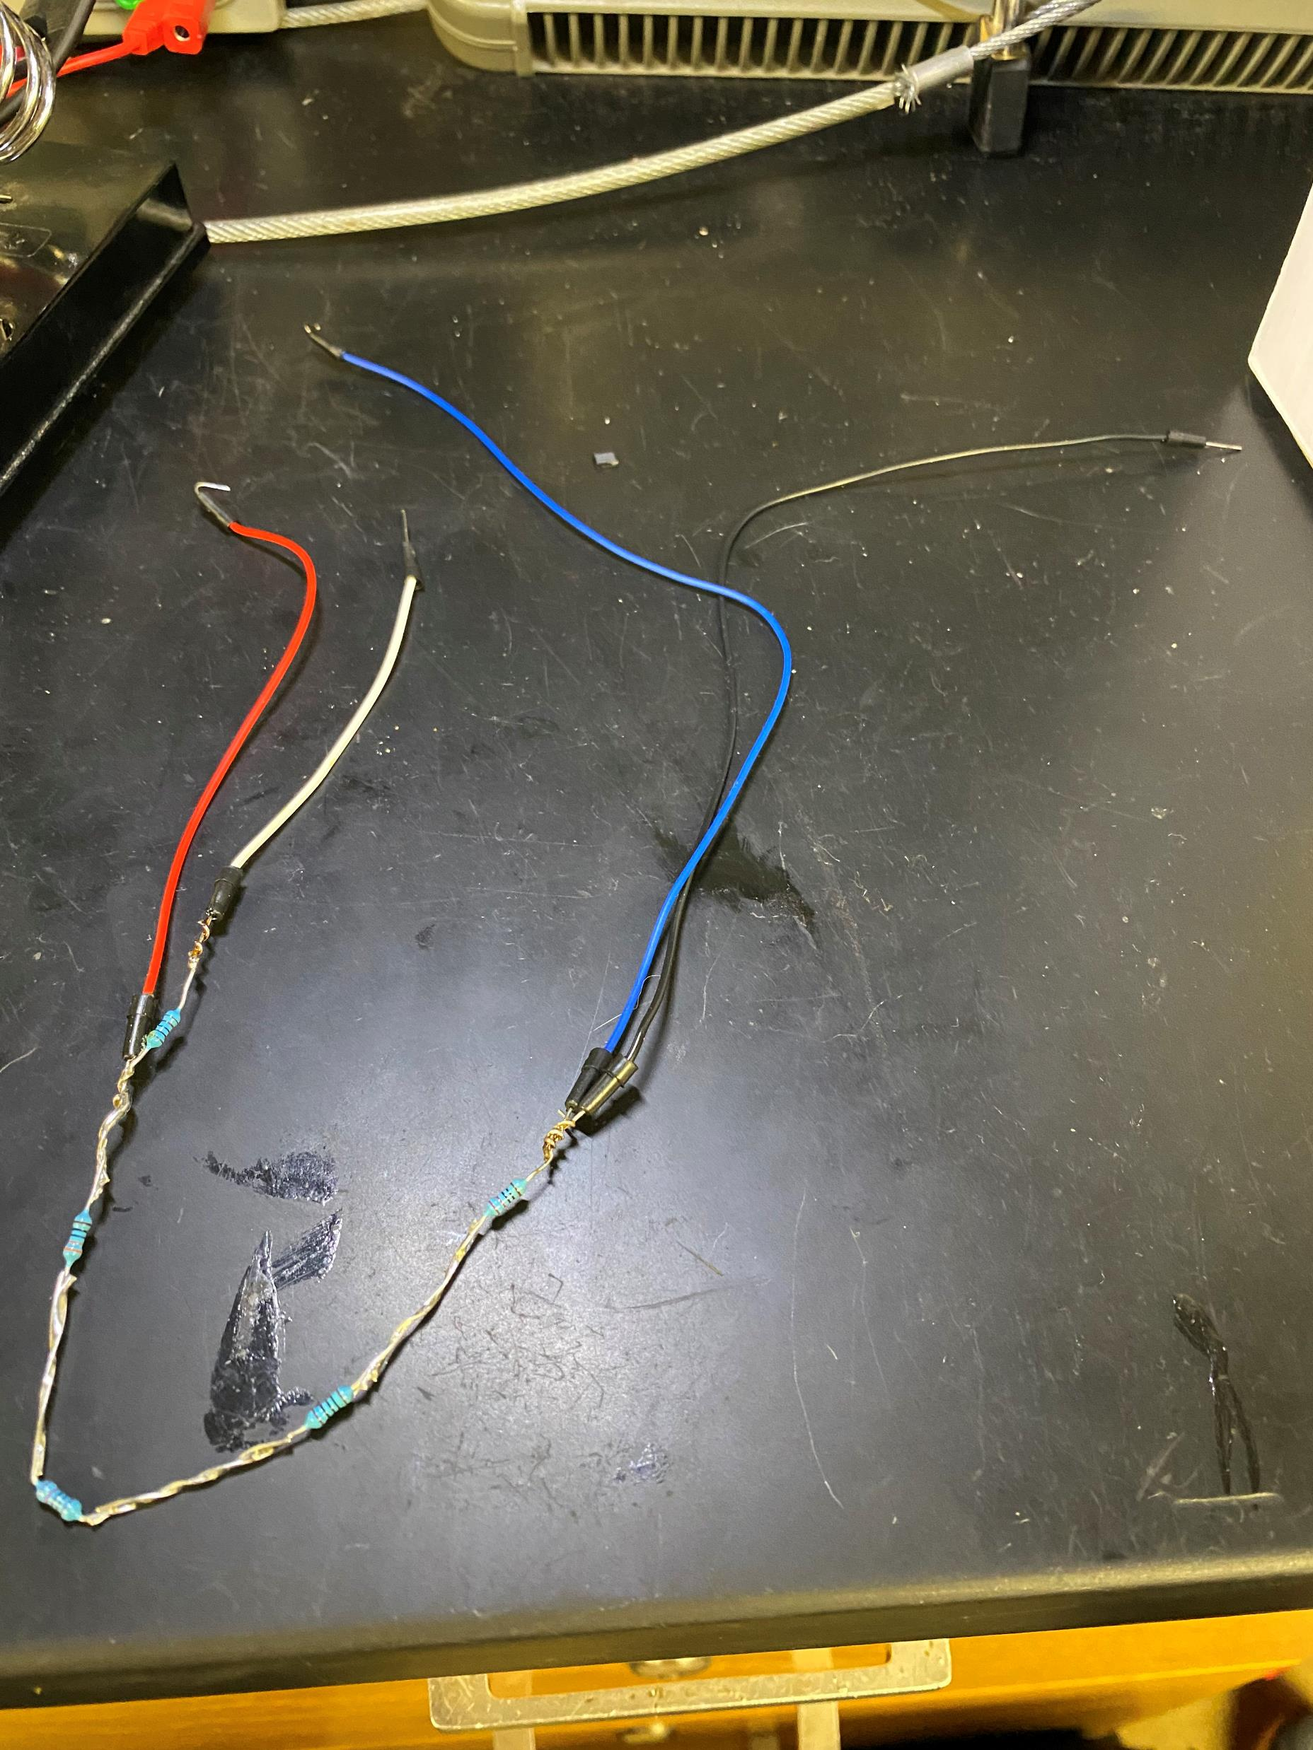
Hardware Update

Slide 8
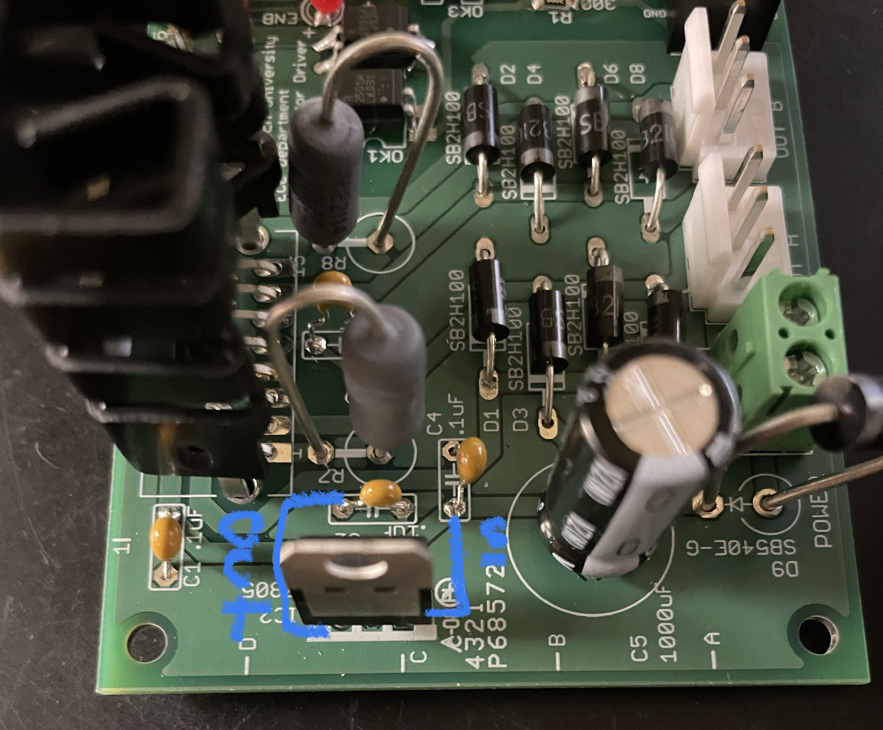
Hardware Update

Slide 9
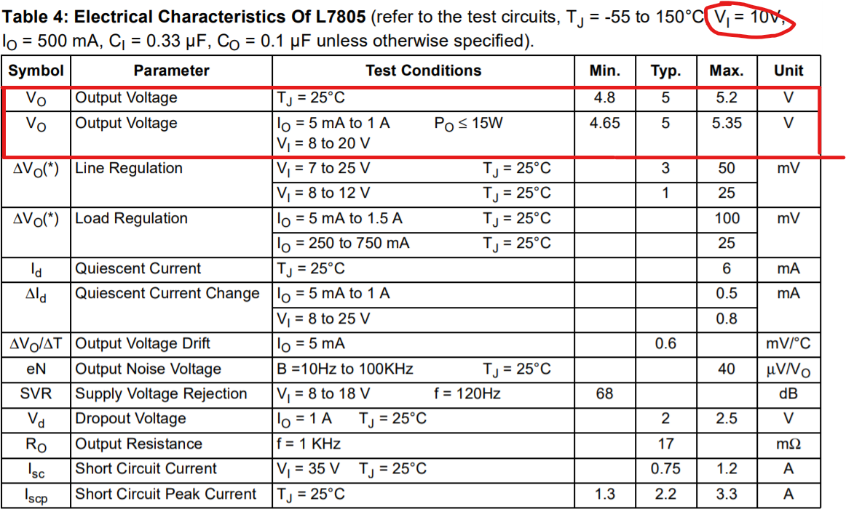
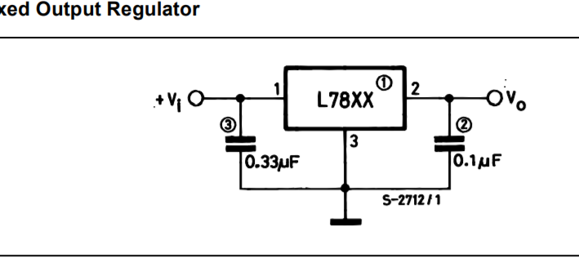
Hardware Update

Slide 10
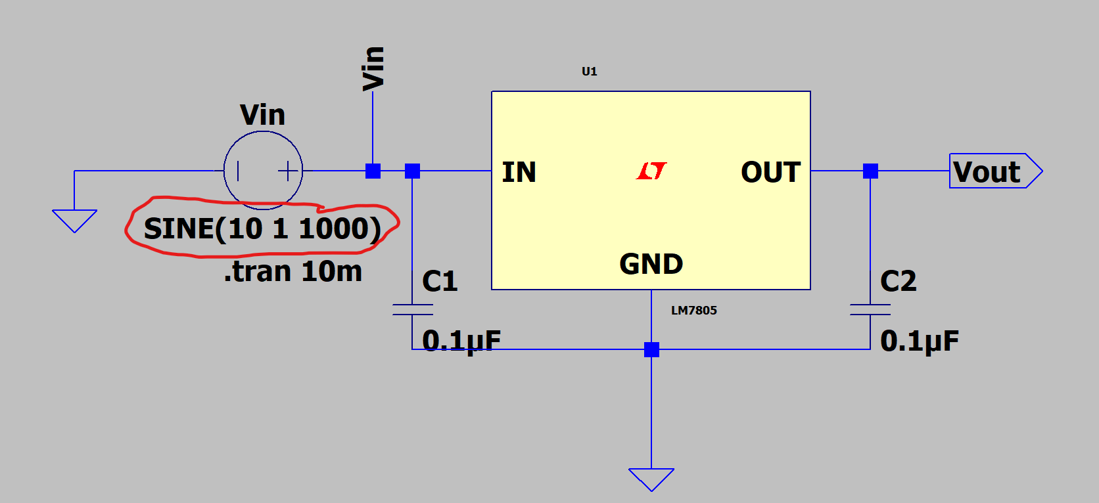
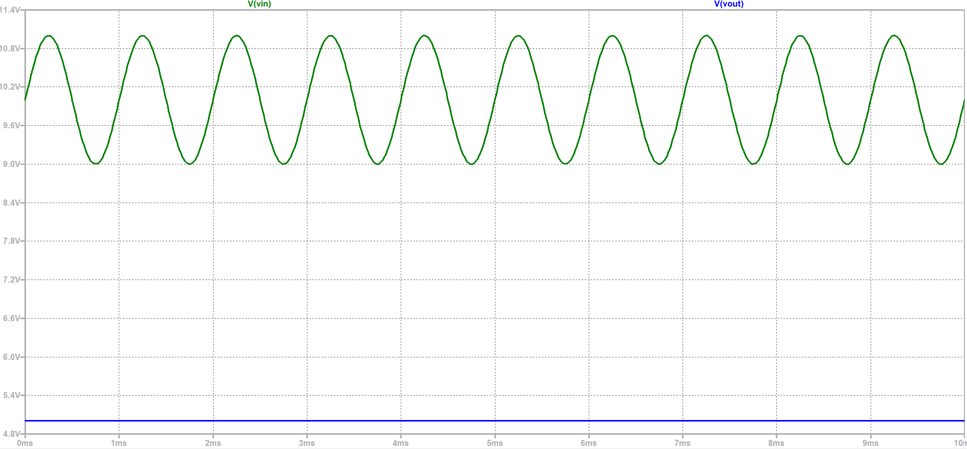
Hardware Update

Slide 11
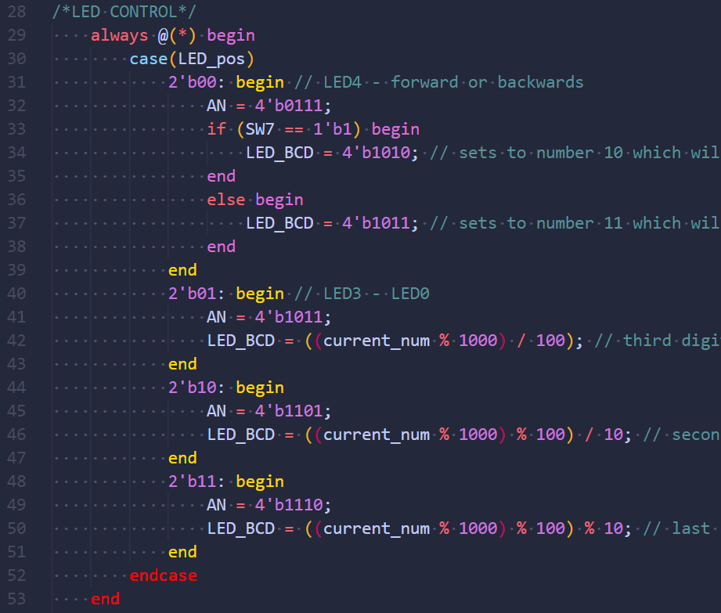
Software Update

Slide 12
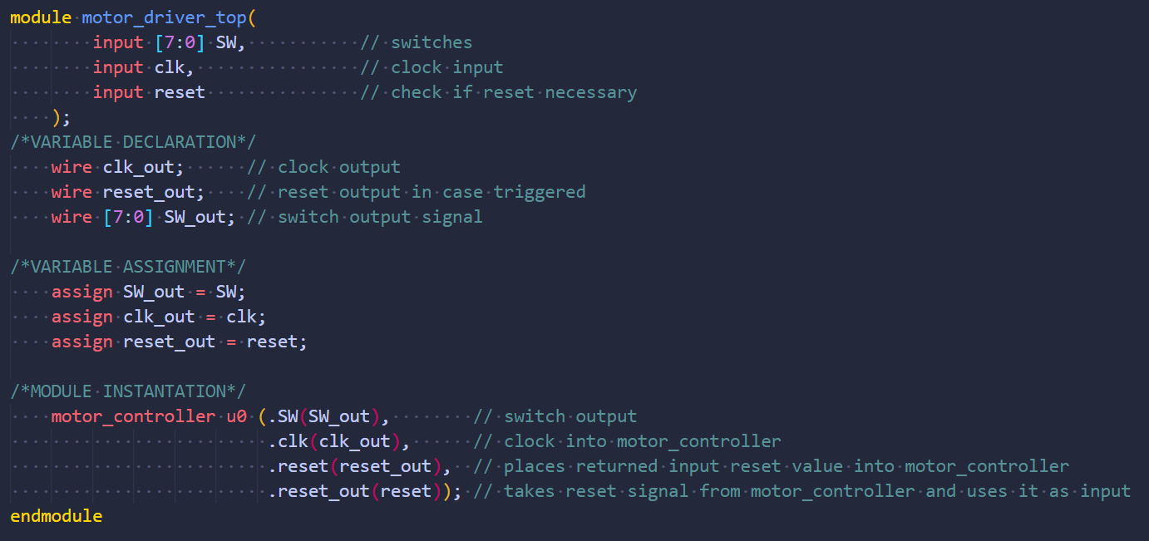
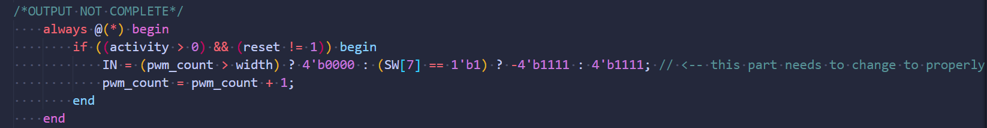
Software Update

Slide 13
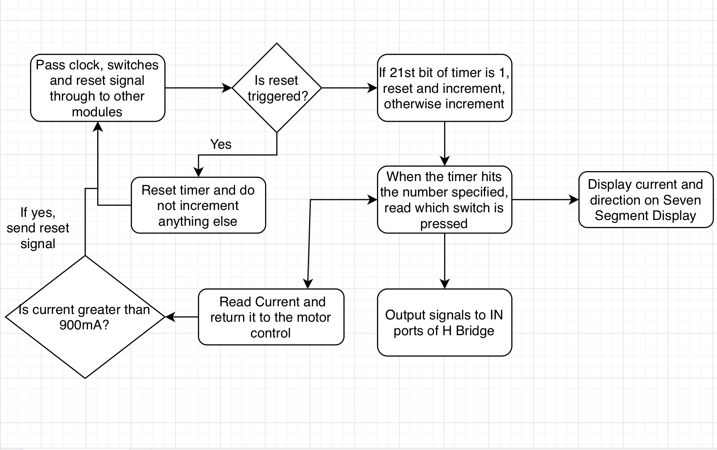
Software Update

Slide 14
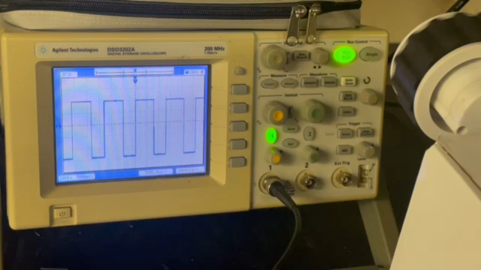
The Rover

Slide 15
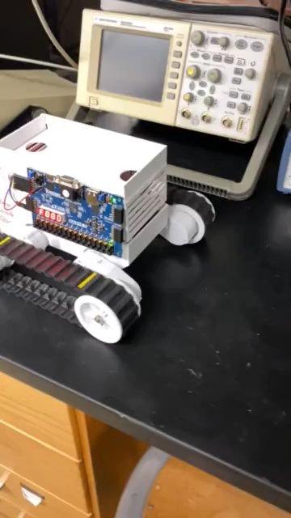
The Rover

Slide 16
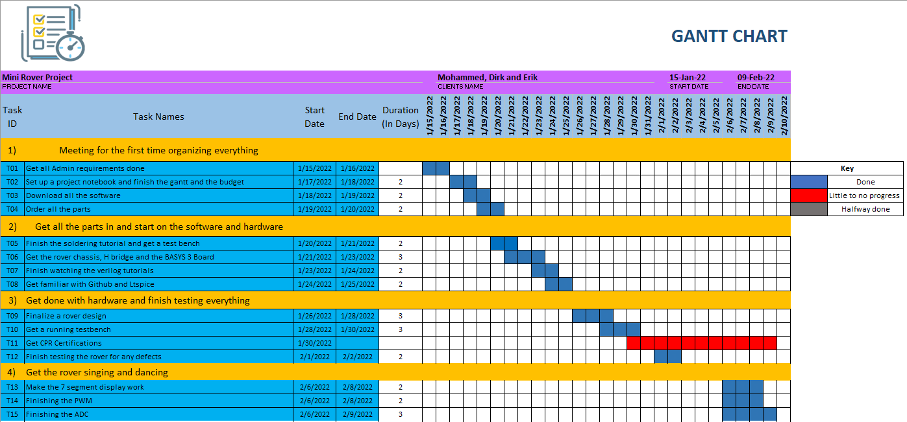
Gantt

Slide 17
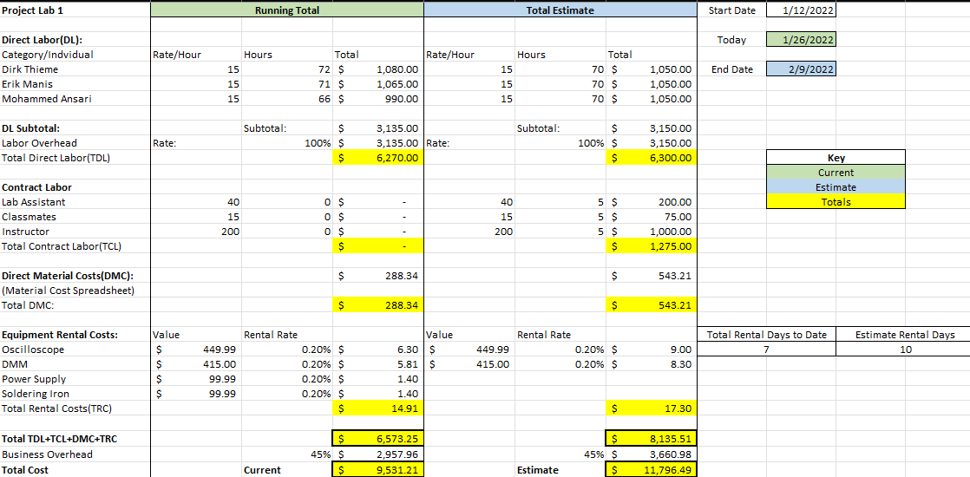
Overall Budget

Slide 18
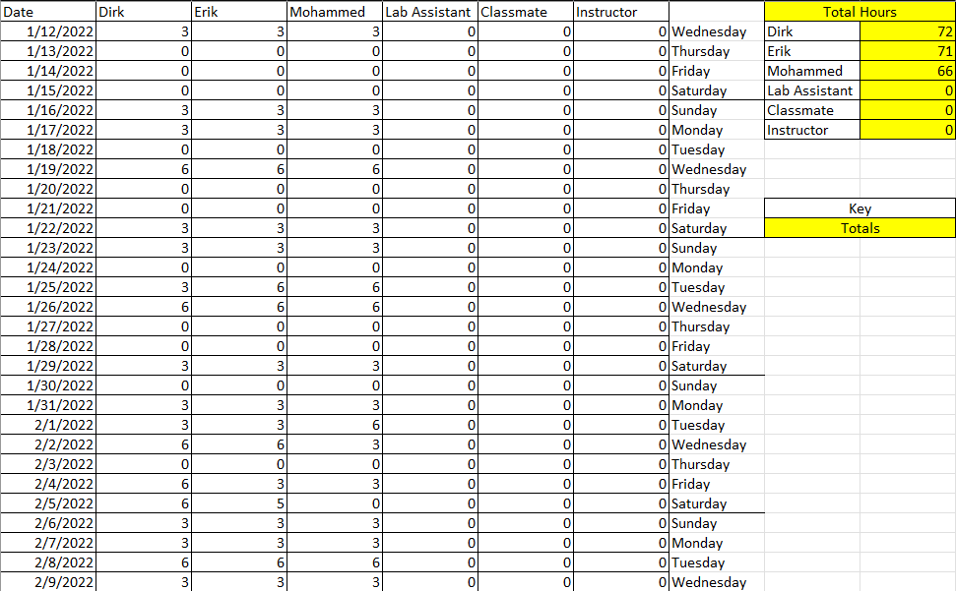
Labor Costs

Slide 19
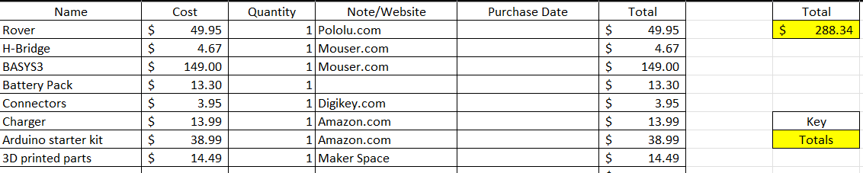
Material Costs

Slide 20

Questions
Software Manager: Dirk Thieme
Hardware Manager: Erik Manis
Project Controller: Mohammed Ansari
This Photo by Unknown author is licensed under CC BY.

